Slide 1

Multilingual Joint Fine-tuning of Transformer models for identifying Trolling, Aggression and Cyberbullying at TRAC 2020
Sudhanshu Mishra, Indian Institute of Technology, Kanpur
Shivangi Prasad, University of Illinois Urbana Champaign
Shubhanshu Mishra, University of Illinois Urbana Champaign
https://github.com/socialmediaie/TRAC2020
Notes:
Pretrained models, source code for training and inference, and evaluation metrics.

Slide 2
Our Contribution
Fine-tuned pre-trained transformer models on TRAC 2020 Aggression and Misogyny identification Task.
Joint label training for solving both the tasks simultaneously. Inspired from our earlier work: https://github.com/socialmediaie/HASOC2019
Multi-lingual models which predict on all languages.
Open source code available at: https://github.com/socialmediaie/TRAC2020
Pre-trained models + evaluation metrics available at: https://doi.org/10.13012/B2IDB-8882752_V1
Models can be further fine-tuned and investigated. Details at GitHub page.

Slide 3
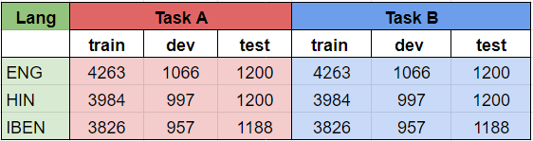
Task Description
TEXT
English (ENG)
Hindi (HIN)
Bengali (IBEN)
Task A
Task B
Aggression
Misogynistic Aggression
Overtly Aggressive
(OAG)
Gendered
(GEN)
Covertly Aggressive
(CAG)
Non-Gendered
(NGEN)
Non Aggressive
(NAG)

Slide 4
Our Approach
Text
Sequence of tokens
Vector representation using pre-trained model
Task specific prediction
Fine-tune the model based on training data

Slide 5
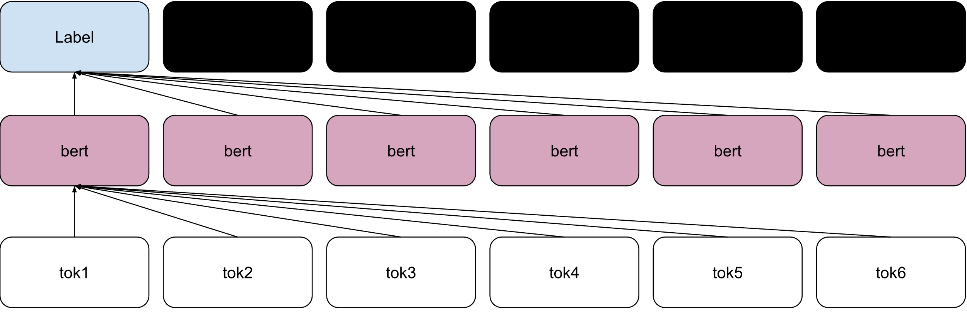
Transformer models for classification

Slide 6
Fine-Tuning Techniques
For all of our experiments we fine tuned different transformer models using the HuggingFace transformers library. We tried three different methodologies:
Single task models
Joint label training for both tasks (C)
Marginalization of output probabilities (M)
Joint training of all languages (ALL)
During our experiments, we tried different combinations of the above methods.
Top models based on dev set performance were submitted.

Slide 7
Joint Label Training (C)
If we combine the labels from all tasks, we can convert the original problem into six label classification problem, as shown below. (Similar to Mishra 2019)
Model trained reduces the inference time computational cost to just doing inference with a single model.
Task A
Task B
NAG
CAG
OAG
GEN
NGEN
NAG-GEN
CAG-GEN
OAG-GEN
NAG-NGEN
CAG-NGEN
OAG-NGEN
Task C

Slide 8
Marginalization of Labels (M)
The label probabilities from the joint label model (C) can be marginalized to get probabilities for each task label. [Only used during inference, not training]
This should result in a valid probability distribution for each task, which is useful for correct inference probability.
P( )
=
P( )
+
P( )
NAG
NAG-GEN
NAG-NGEN

Slide 9
Joint training of all languages (ALL)
HIN and IBEN lack pre-trained models, but multi-lingual pre-trained models are available. We fine-tune those using training data from all languages.
This results in a single model for all languages, making the final model computationally cheaper to perform inference for all languages.
ENG
ALL
ENG
Multi-Lingual Model
HIN
HIN
IBEN
IBEN
Notes:
Utilizing the power of multi-lingual models, we can train our models for all the three languages, by combining their datasets. This methods provides us with a single model for all the languages, which makes it much more suitable for large scale deployment.

Slide 10
Experiments Conducted
We utilized various combinations of the techniques that we have mentioned. Following transformer models were fine-tuned.
ENG
HIN
IBEN
Bert-base-uncased
Bert-base-cased
Bert-base-multilingual-uncased
Xlm-roberta-base
Bert-base-multilingual-uncased​
Xlm-roberta-base​
Bert-base-multilingual-uncased​​​​
Xlm-roberta-base​​
A more detailed analysis of the experiments is mentioned in the systems paper.

Slide 11
Final Results
Our best performing model came:
2nd in 1/6 sub-tasks: ENG A
3rd in 3/6 sub-tasks: HIN A, B, and IBEN B.
4th in 1/6 sub-tasks: ENG B.
The top models of Julian used ensemble based approach while all of our models required single model inference (sometimes even for all tasks and languages).
The second best models of abaruah used SVM for top models.
The closest approach to ours is Ms8qQxMbnjJMgYcw, which trains BERT using multi-task setting, which performed similar to ours.

Slide 12
Final Results Task A

Slide 13
Final Result Task B

Slide 14
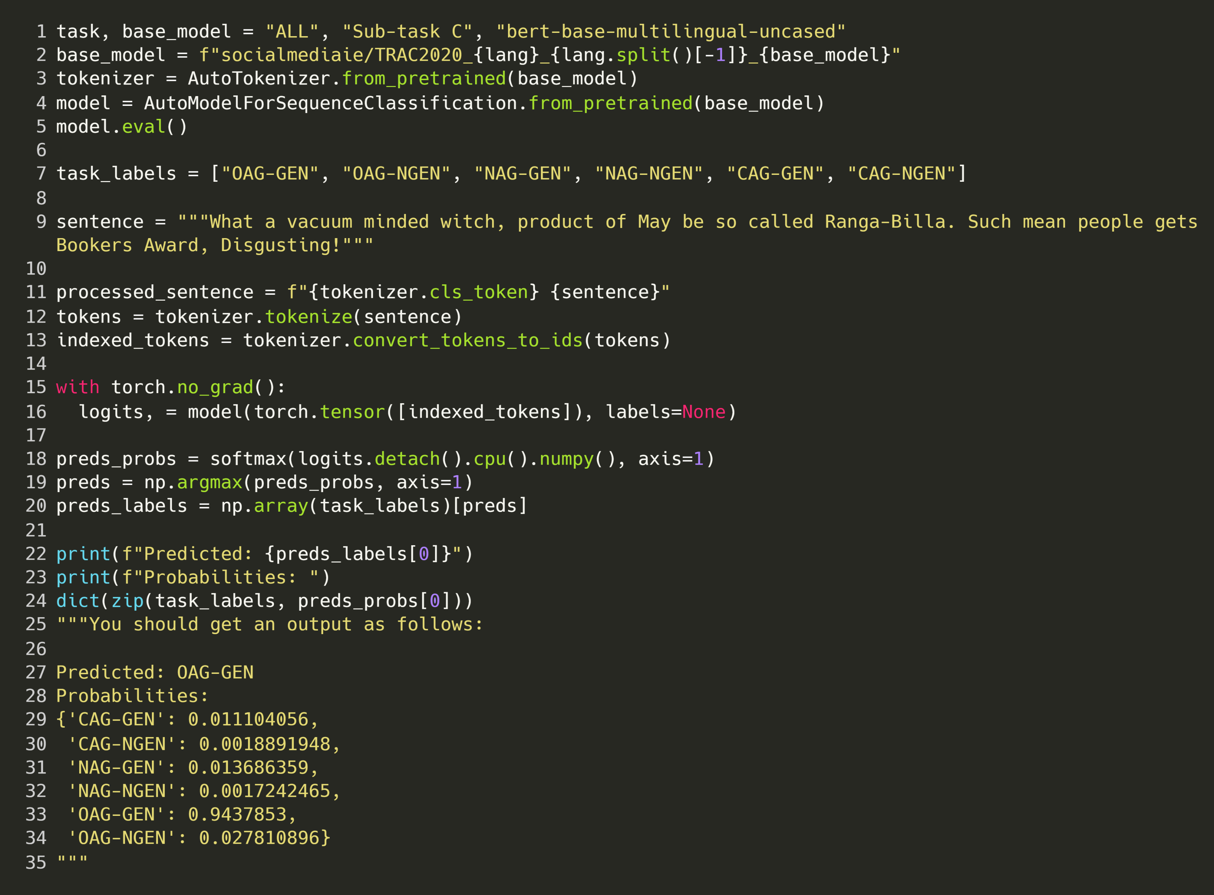
Re-use our pre-trained models for inference on your own data in just a few lines of code using transformers library

Slide 15
Conclusion
We found fine-tuning pre-trained transformer models results in a competitive performance on all TRAC 2020 tasks.
Joint label and multi-lingual training allowed us to address data sparsity issue and this was the best approach for HIN and IBEN datasets.
ALL models are the computationally cheapest models for inference.
Code for reproducing our results can be found at: https://github.com/socialmediaie/TRAC2020

Slide 16
References
Mishra, Sudhanshu, Shivangi Prasad, and Shubhanshu Mishra. 2020. “Multilingual Joint Fine-Tuning of Transformer Models for Identifying Trolling, Aggression and Cyberbullying at TRAC 2020.” In Proceedings of the Second Workshop on Trolling, Aggression and Cyberbullying (TRAC-2020).
Mishra, Shubhanshu, and Sudhanshu Mishra. 2019. “3Idiots at HASOC 2019: Fine-Tuning Transformer Neural Networks for Hate Speech Identiﬁcation in Indo-European Languages.” In Proceedings of the 11th Annual Meeting of the Forum for Information Retrieval Evaluation, 208–13. Kolkata, India. http://ceur-ws.org/Vol-2517/T3-4.pdf.
Mishra, Shubhanshu, Shivangi Prasad, and Shubhanshu Mishra. 2020. “Trained Models for Multilingual Joint Fine-Tuning of Transformer Models for Identifying Trolling, Aggression and Cyberbullying at TRAC 2020.” University of Illinois at Urbana-Champaign. https://doi.org/10.13012/B2IDB-8882752_V1.
Mishra, Shubhanshu. 2019. “Multi-Dataset-Multi-Task Neural Sequence Tagging for Information Extraction from Tweets.” In Proceedings of the 30th ACM Conference on Hypertext and Social Media - HT ’19, 283–84. New York, New York, USA: ACM Press. https://doi.org/10.1145/3342220.3344929.

Slide 17
Thank You
Our paper: Mishra, Sudhanshu, Shivangi Prasad, and Shubhanshu Mishra. 2020. “Multilingual Joint Fine-Tuning of Transformer Models for Identifying Trolling, Aggression and Cyberbullying at TRAC 2020.” In Proceedings of the Second Workshop on Trolling, Aggression and Cyberbullying (TRAC-2020).
More tools related to social media information extraction can be found at the SocialMediaIE project: https://socialmediaie.github.io/
There will be a hands-on tutorial on Information extraction from social media using SocialMediaIE at LREC 2020: https://lrec2020.lrec-conf.org/en/workshops-and-tutorials/tutorials/
Contact:
Sudhanshu Mishra: https://twitter.com/SudoMishra
Shivangi Prasad: https://twitter.com/shivangiPhy
Shubhanshu Mishra: https://shubhanshu.com/

Slide 18
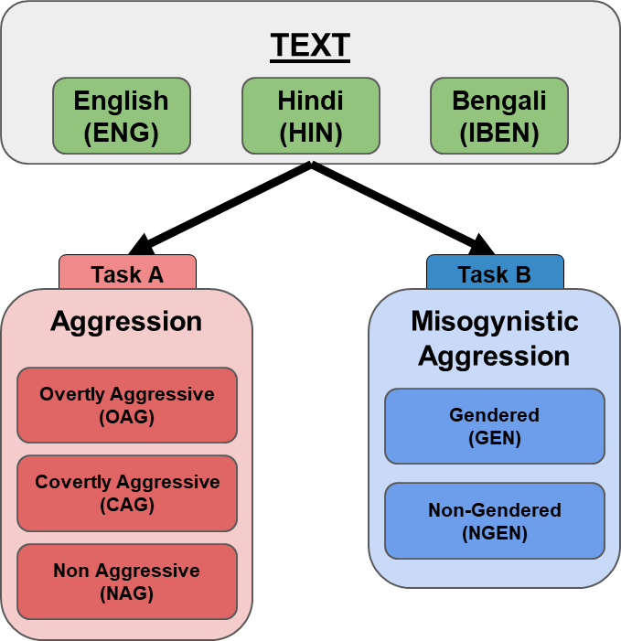
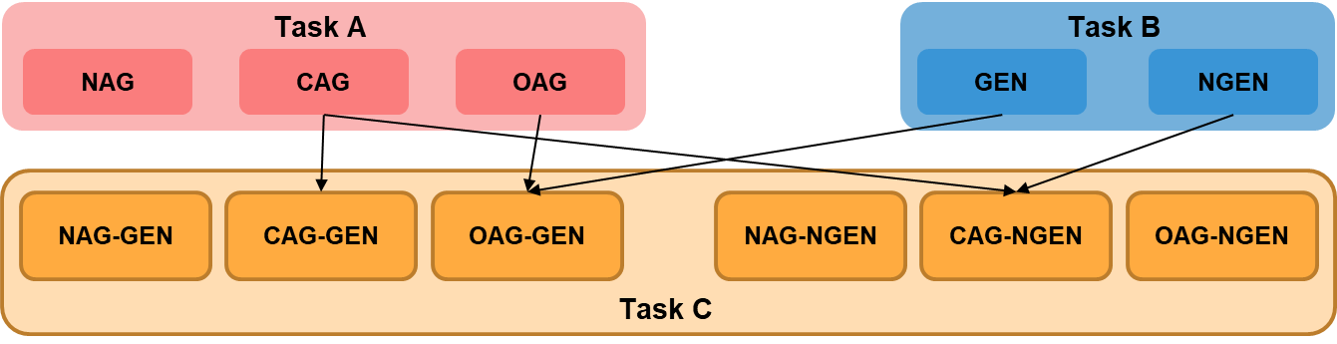
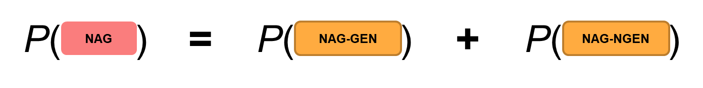
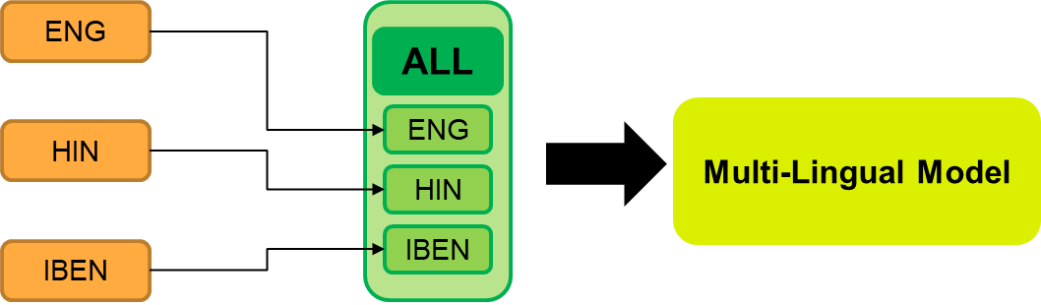
Multilingual Joint Fine-tuning of Transformer models for identifying Trolling, Aggression and Cyberbullying at TRAC 2020
https://github.com/socialmediaie/TRAC2020
2nd in 1/6 sub-tasks: ENG A
3rd in 3/6 sub-tasks: HIN A, B, and IBEN B
4th in 1/6 sub-tasks: ENG B
Computationally faster and cheaper inference cost.

